Slide 1
Group 9: Silent Cartographer
Elena Orozco, Hussain Ali, Emaad Rahman, Amir Nazemi, Kevin Santhosh

Slide 2
Problem & Constraints
The Challenges
Solve the maze with different hazard types
Agent has no prior map, must build knowledge from scratch
Receives only local feedback via TurnResult each turn
Cannot see ahead of itself
Must navigate from start to goal efficiently
Hazard types
Fire
Kills agent on contact; pits rotate every turn
Confusion
Inverts movement directions for following turn
Teleport
Red, green, orange, purple — relocates the agent if stepped on.

Slide 3
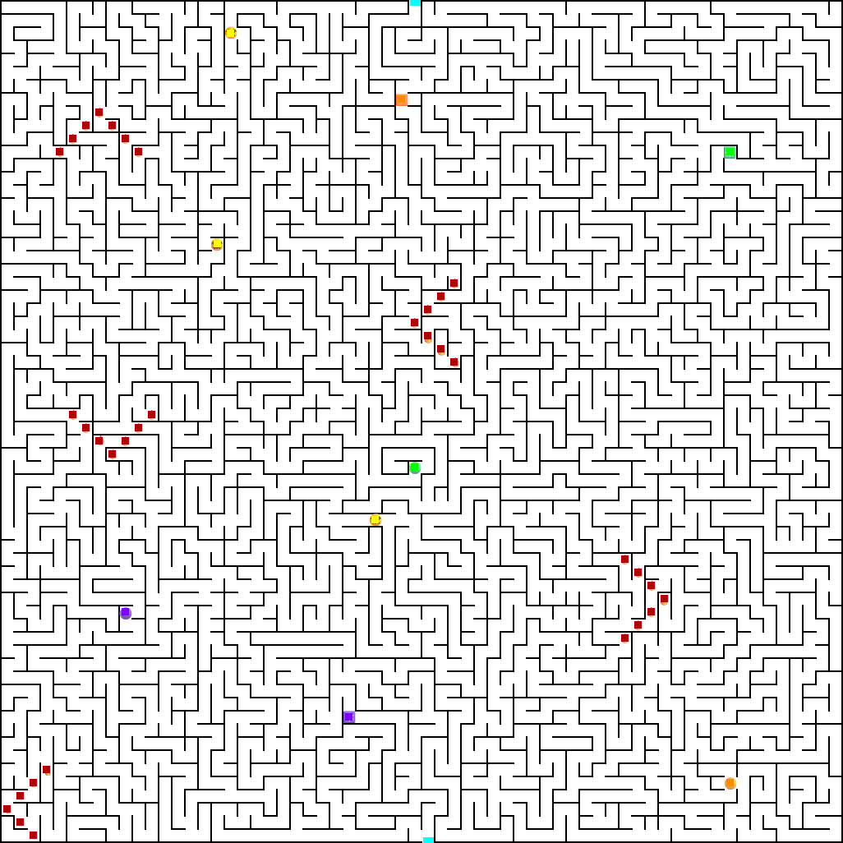
Hazard Classification
Initial approach used HSV color filtering
Used template matching + HSV for tie-breaker
14x14px templates of each hazard created
Compares each cell interior against template and returns best score
Labels each hazard type with different color squares
Notes:
Couldnt find the right numbers for HSV to work so
Settled on using 14x14px templates to match the cell interiors to hazards and using HSV as a tie breaker instead

Slide 4
Method used
We used a combination of D* Lite and Evolutionary Computing
Genetic Algorithm evolves neural network weights
D* Lite handles optimal pathfinding and replanning
NN manages the hazard specific decisions
Fire timings and decisions to either pass or avoid
Teleporters whether using the teleport is efficient
Confusion
Notes:
We tried q-learning +BFS, tried A* but weren’t able to find a working solution without coding in heuristics.
Q-learning +BFS was too scared, looking back our Q table probably wasn’t high enough

Slide 5
Hazard Handling
Fire Hazard | Cells marked 'death' in known map after dying to it. Agents will explore beyond by waiting for fire to pass if it determines it is more optimal
Confusion Hazard | Detected withTurnResult.is_confused flag Agent tracks confused_turns_left counter All outgoing actions are inverted to compensate
Teleporter Hazard | Detected when position jumps unexpectedly vs intended action Teleport_map built dynamically and are saved as bidirectional D* Lite routes through beneficial teleporters to shorten path
Notes:
Cells

Slide 6
Why Evolutionary Learning
Although training times are higher, it has the potential to produce a more adaptable result
Maze is partially observable
Agent has no map and cannot see ahead of itself
Genetic algorithm evaluates entire episodes as fitness scores
Provides stronger learning signal than per step RL
GA evolves NN weights globally across a population
No gradient -> wont get stuck in local optima
Two phase fitness function: first rewards exploration coverage, then minimizes turns and deaths once the goal is rechable

Slide 7
Training & Performance
Pop of 80 with 60 gens training episodes with immigrants that prioritize exploration
7000 turns per episode due to compute time
Greedy exploration decays over time
Reward Function
+120,000 for reaching goal
-750 x deaths
-15 x (wall hits)
-3 x (visit count) -> penalize revisiting cells
+300 x (Manhattan distance to goal) -> moving closer to goal
Optimizing mode enabled with different weights once goal is reached
Has different weights
Neural Network features — 43 inputs
Observations:
Early random exploration
Faster completion time as gens pass
Increasing map knowledge across episodes via immigrants

Slide 8
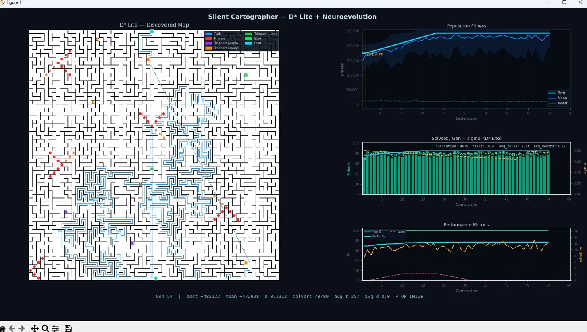
Agent Training

Slide 9
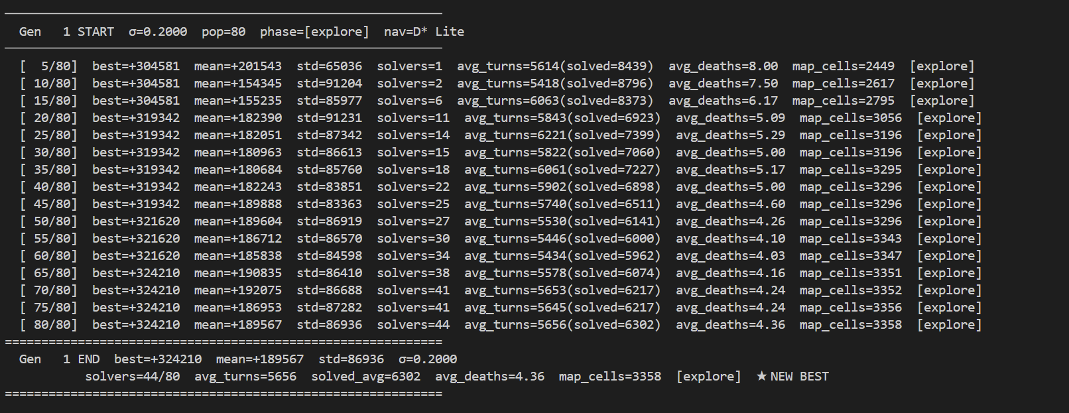
Agent Training Cont

Slide 10
Evaluation Metrics
Beta
Bonus
Beta
Success Rate
100 %
Exploration Eff.
0.21 c/t
Avg Path Length
859 cells
Map Completeness
69.2 %
Avg Turns
2554
Replanning Eff.
60 %
Death Rate
1.2/ep
Learning Eff.
95.4 %

Slide 11
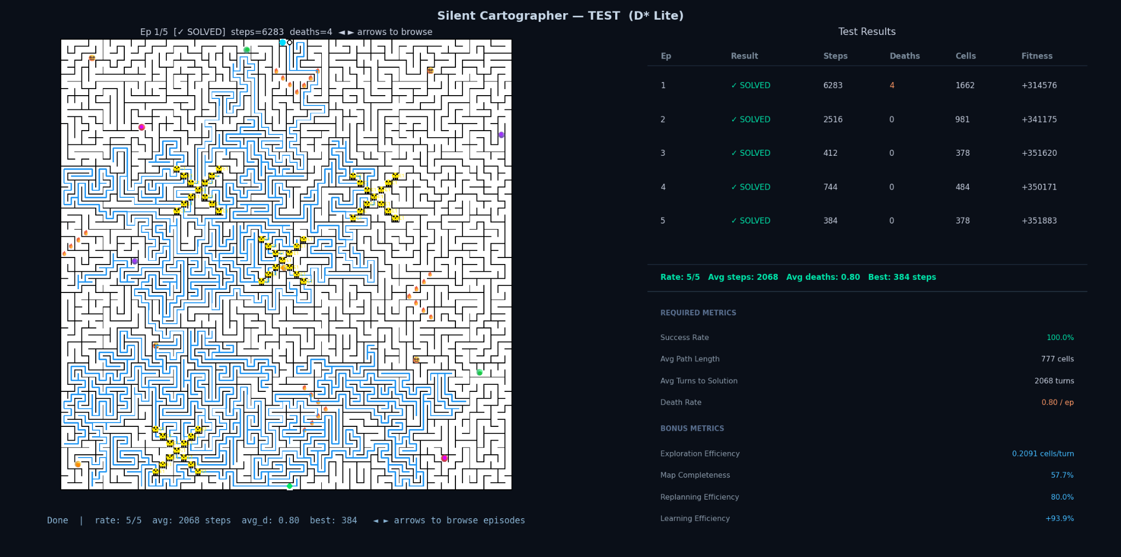
Beta Demo
Notes:
Just do a commentary over what the agent is doing while we run it
.2 cells/turn means we spent a lot of time waiting, not necessarily a bad thing, meant the agent is thinking.
Replanning efficiency shows

Slide 12
Thank you

Slide 13
Episode 1
Episode 2

Slide 14
Episode 3
Episode 4

Slide 15
Episode 5

